Slide 1

Guru99 Bank
GB
Version 1.3

Slide 2


Guru99 Bank
This is a website that provide net banking facility to its customers.
The objective of testing is to verify that the «Guru99 Bank» website works as it is intended. The following activities will be performed:
Verify functional correctness.
Verify correct displaying of modules.

Slide 3




NOT to be tested
Automation testing
Features to be tested
Functional
GUI
Features to be tested
The banking site will be only compatible with Chrome version 27 and above.
NOT to be tested
TESTING SCOPE
Stress
Performance

Slide 4
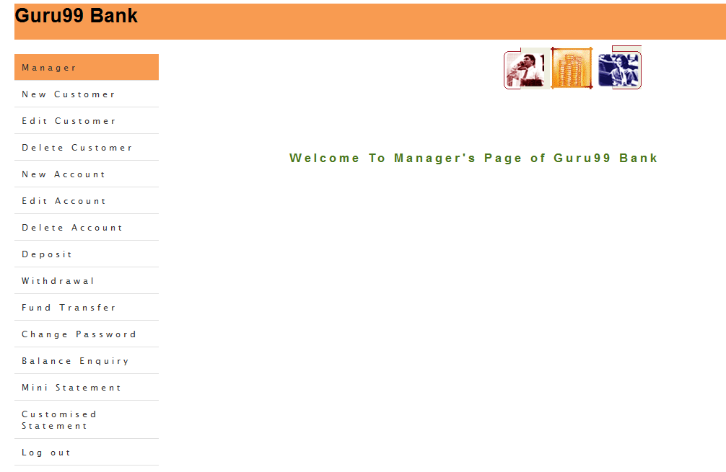
TESTING SCOPE

Slide 5
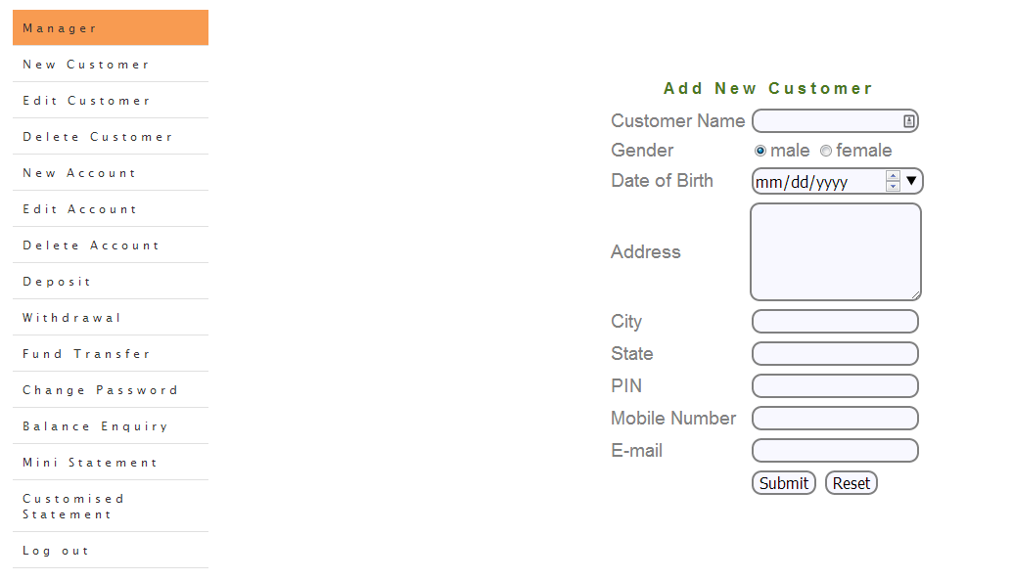
TESTING SCOPE

Slide 6
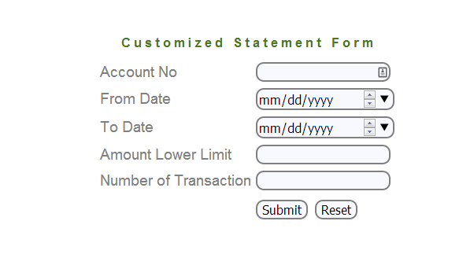
TESTING SCOPE

Slide 7
TEST STRATEGY
Test level: Smoke
Investigate entry criteria
End-to-End
Functional
GUI
Test documentation
Method Black-box testing
System Testing
Integration Testin
Unit Testing

Slide 8




40% of test cases failed
If the team members report that there are 40% of test cases failed, suspend testing until the development team fixes all the failed cases.
Test cases are executed
Testing is stopped after all test cases are executed
Acceptance
criteria
Test completeness pass is 80%

Slide 9
Design test
Testing Schedule
Create the test specification
Design test
Execute Test
Analysis Test
Prepare Reports
Design test | Test Designer | 16 man/hours | 07.06.2021 | 08.06.2021
Design test | Test Designer | 16 man/hours | 07.06.2021 | 08.06.2021
Tester
Test Designer
8 man/hours
06.06.2021
8 man/hours
13.06.2021
Test Designer
24 man/hours
09.06.2021-11.06.2021
16 man/hours
07.06.2021-08.06.2021
3 man/hours
12.06.2021

Slide 10





RESOURCES
Responsibility
Software
Internet line
Documentation
Alina
QA engineer
Chrome version:
91.0.4472.101
Microsoft Windows [Version 10.0.19041.1052]
The speed at least 5 Mb/s
Jira Atlassian
Excel
WPS OFFICE

Slide 11
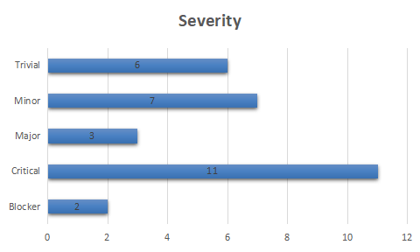
Documentation

Slide 12
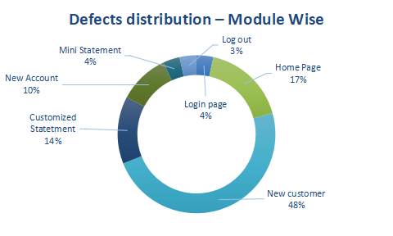
Documentation

Slide 13
RISKS
Probability
Impact
Litle Eperience
Electricity Failure
2
2
Incorrect or incomplete stated requirements
The number of bugs significantly exceeds the expected number
9
6
Project deadline not met
Changing priorities in project management
9
3
Priority

Slide 14

PASS

